Slide 1
A Measurement Study of Oculus 360 Degree Video Streaming
Chao Zhou¹, Zhenhua Li², Yao Liu¹
¹ SUNY Binghamton
² Tsinghua University

Slide 2
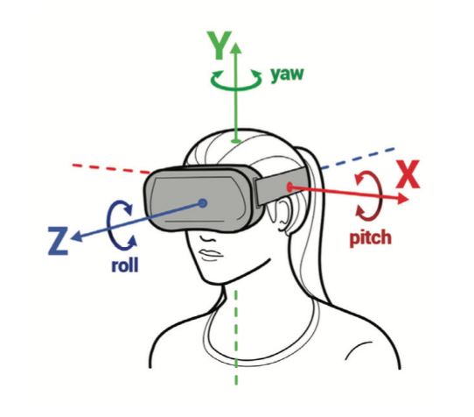
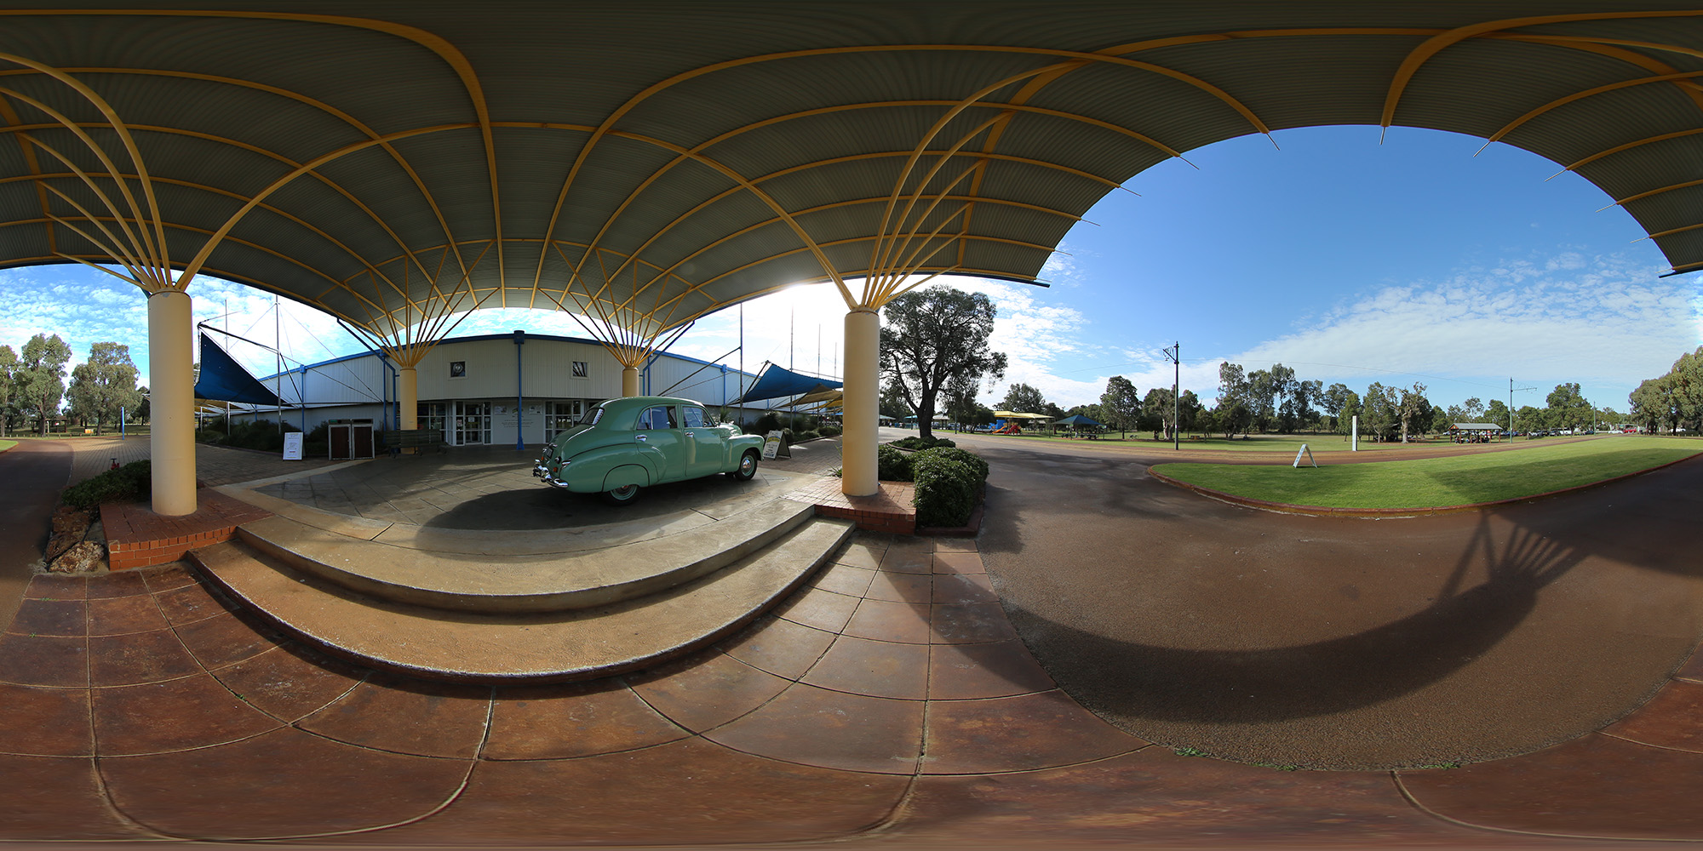
Introduction to 360 Degree Video Streaming
360 degree video streaming:
It provides users with panoramic view and allow users to freely control their viewing direction during playback.
+
=
[Proceedings of the 5th Workshop on All Things Cellular, 2016, Qian et al., Optimizing 360 video delivery over cellular networks.]
http://paulbourke.net/miscellaneous/cubemaps/
Notes:
On the serve side
On the client side

Slide 3
Key Challenges of 360 Degree Video Streaming
Bandwidth shortage
Head-mounted display and stereoscopic videos
25Mbps bandwidth is required by delivering 4K video, where the average broadband connection bandwidth in the USA is only 15.3Mbps.
More Streaming data used for stereoscopic videos !
http://mediashift.org/2017/03/edshift-chat-trends-and-tips-in-360-video/

Slide 4
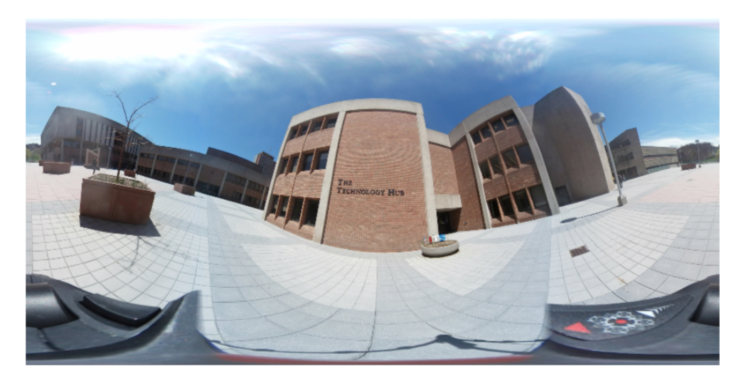
Key Challenges of 360 Degree Video Streaming
Bandwidth waste
Only small part of frame is visible to the user at once.
A viewport, centered at <yaw = 0, pitch = 0> only requires about 14.3% of all pixels encoded in the equirectangular frame, the rest of 85% pixels are wasted.

Slide 5
Equirectangular Projection
Over-sampled data on the pole positions
Many 360 degree video streaming services today encode videos using the equirectangular projection including YouTube and Jaunt VR.

Slide 6
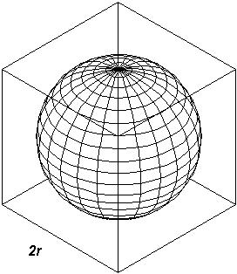
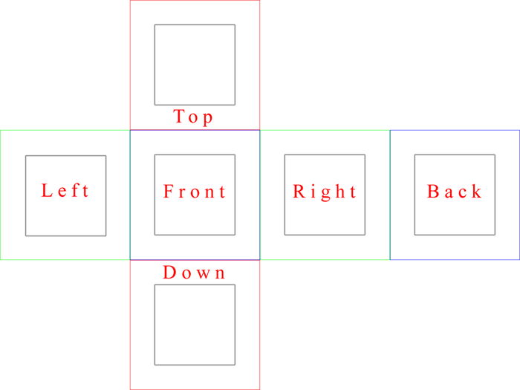
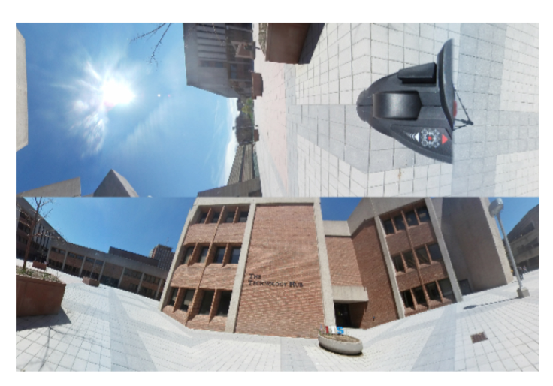
Cubic Projection
`
Top
Back
Bottom
Facebook claims that it saves about 25% of video size compare with equirectangular projection
Left
Front
Right
Does Oculus use the same projection method

Slide 7
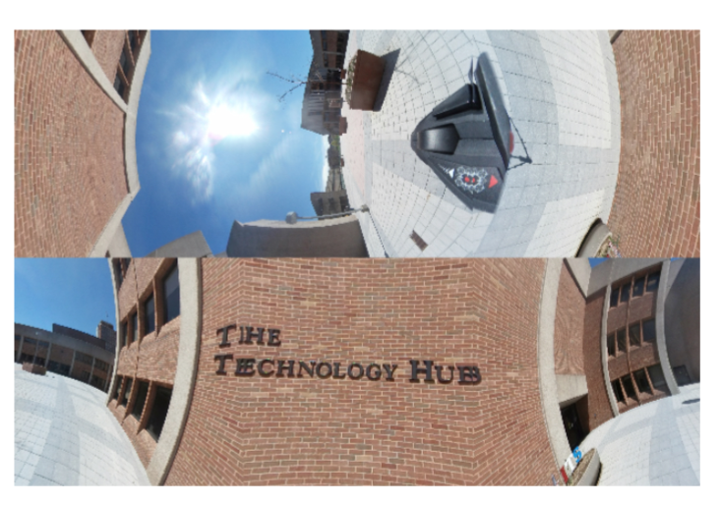
Offset Cubic Projection
Top
Back
Bottom
Top
Back
Bottom
Left
Front
Right
Left
Front
Right
The offset cubic projection
The standard cubic projection
How does this new projection scheme works

Slide 8
Offset Cubic Projection
Front
Front
b
Roughly 30 degrees
a
Orientation
Left
Right
Left
c
Right
Roughly 150 degrees
Back
Back
VS.
The standard cubic projection
The offset cubic projection

Slide 9
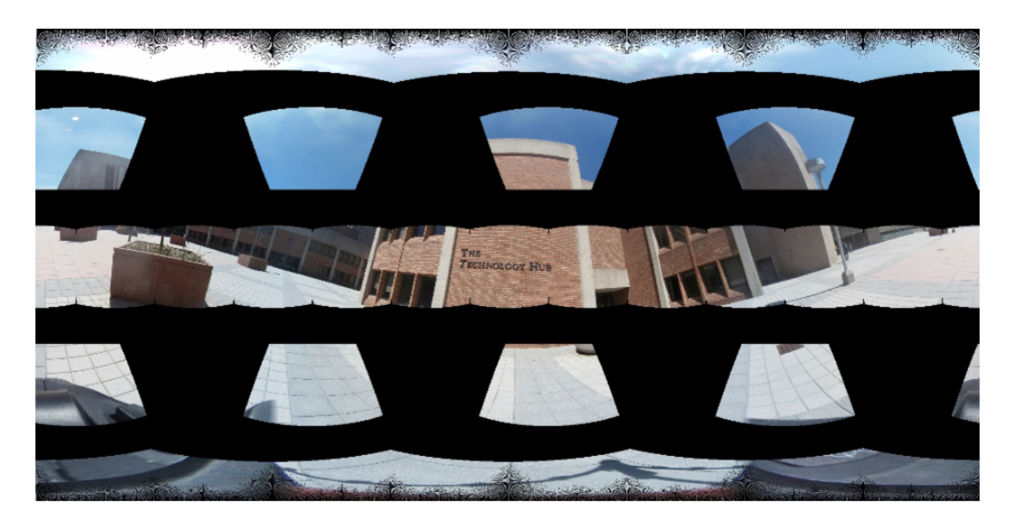
Example of Offset Cube’s Front Faces
The figure of drawing front faces of 22 offset cubes on to an equirectangular image.
Our open source tool can convert images among different types of projection methods, and render user’s views from these projection representations.
https://github.com/bingsyslab/360projection

Slide 10
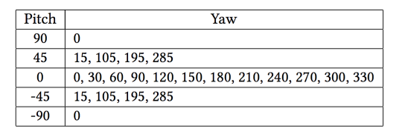
Offset Cubes in Oculus
22 offset cube orientations
88 versions of our 5 minutes test video is 31 GB!
⨉
=
4 quality versions

Slide 11
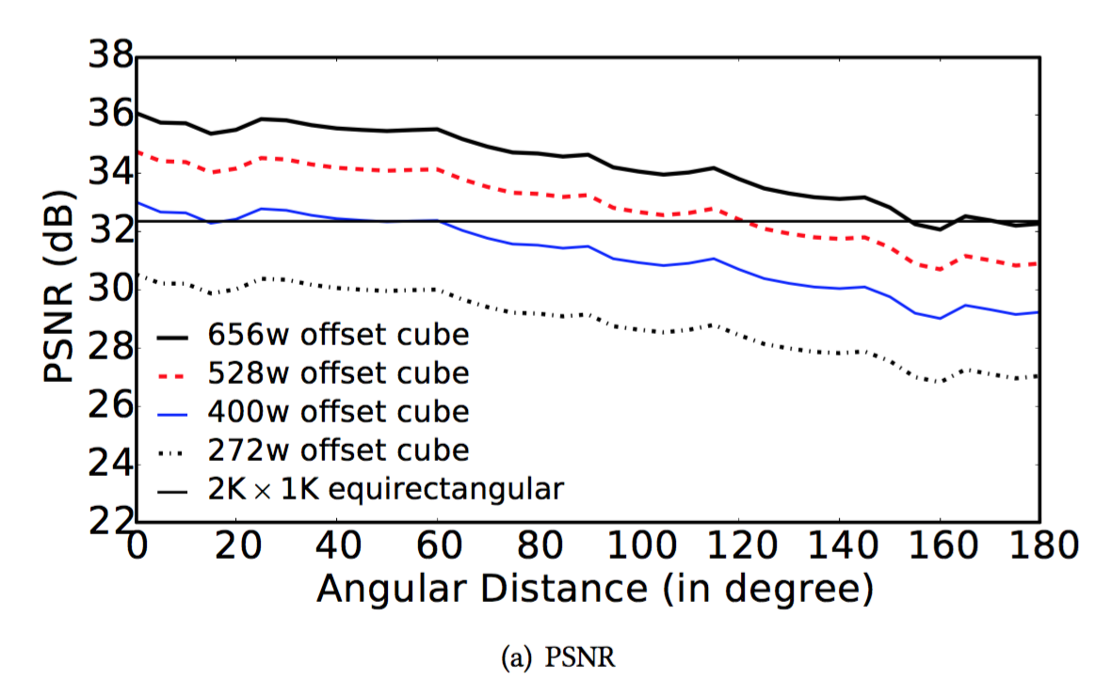
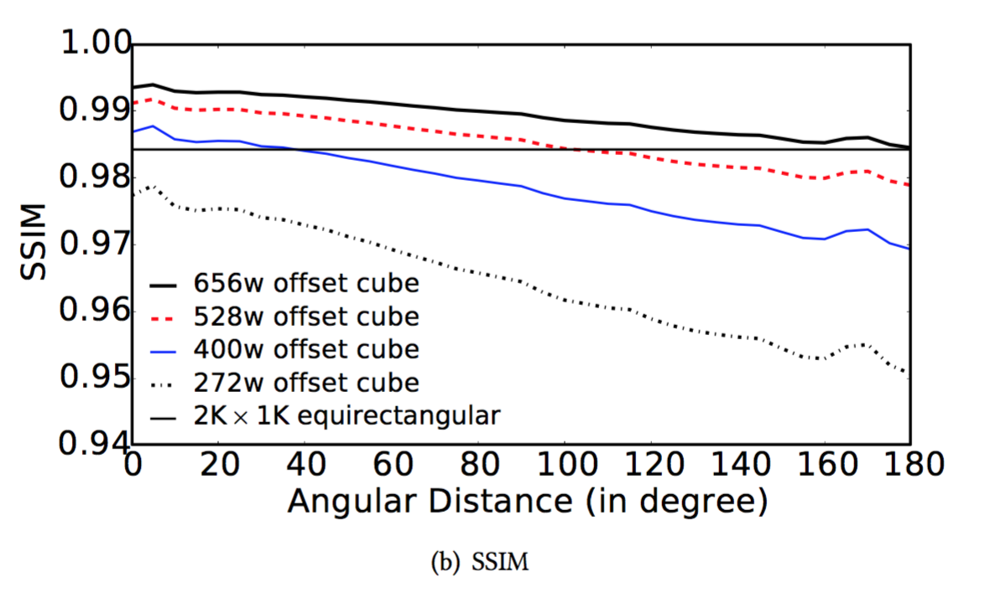
Visual Quality of Offset Cubes
Less than 40 degrees
Save more than 50% pixels
Angle Distance Between Offset Cube and Generated User’s View
Angle Distance Between Offset Cube and Generated User’s View
2K * 1K equirectangular: 2,000,000 pixels
400w offset cube: 960,000 pixels
Notes:
We comapre visual quality of image render by offset cubes and the image rander by eqirectangaluar projection. We use 8K equiretangluar image as baseline for comparsion. Our experiment extract more than 2000 views
For both figure in this slide, the x-axixs represnt angle distance

Slide 12
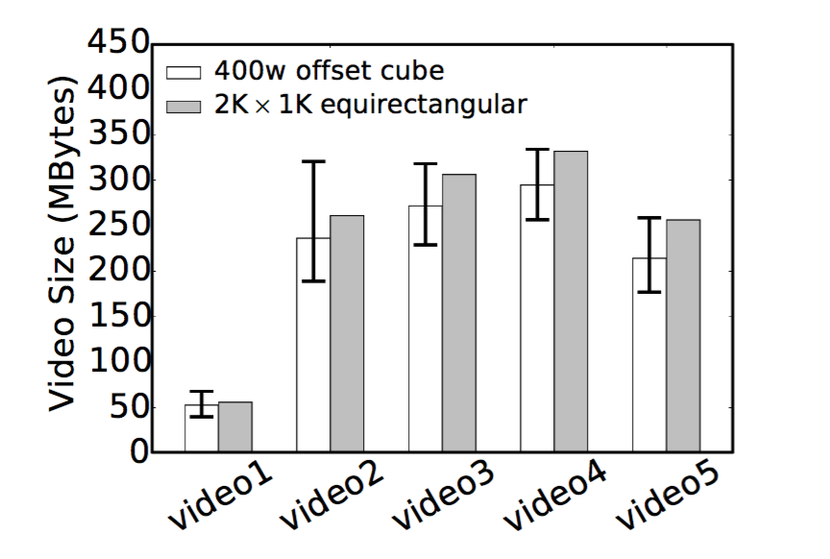
Average Sizes of Offset Cube and Equirectangular
The average file size of 22 offset cubes are only 5.6%, 9.5%, 11.2%, 11.2 % and 16.4% smaller than their corresponding 2K * 1K equirectangular versions.

Slide 13
Streaming Adaptation on Oculus
View orientation adaptation and quality level adaptation.
During streaming, the Oculus player has two decisions to make:
Which of the 22 differently-oriented offset cubes will best match the user’s head orientation?
Which of the 4 quality levels will produce the best performance under the current network condition?

Slide 14
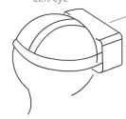
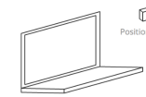
Wasted Segments Caused by Adaptation Algorithm
User’s head orientation match the offset cube orientation can produce the best visual quality.
Oculus player requests new segments to replace pre-download segments in playback buffer to achieve better quality.
Yaw:330 Pitch:0
Yaw:0 Pitch:0
User
Yaw:30 Pitch:0
Server
Left to right
https://msdn.microsoft.com/en-us/library/jj130970.aspx
Notes:
playback buffer

Slide 15
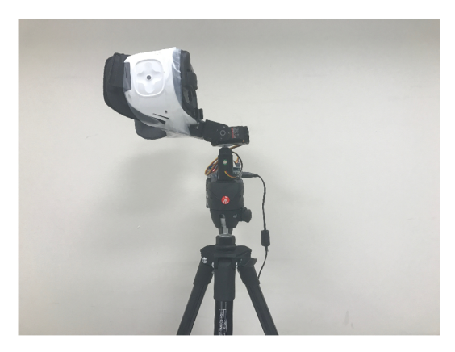
Experiment Setup
How to precisely repeat the same sequence of user’s head movement?
Customized, controllable Pan/Tilt mount with a 3D-printed holder attached to the standard tripod.
Emulate user’s head motion by precisely controlling two servo motors.

Slide 16
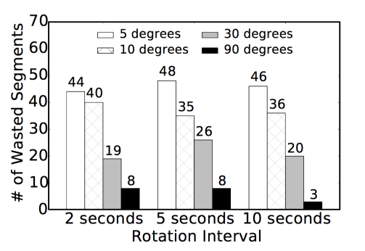
Emulated Tests: View Orientation Adaptation Only
The number of wasted segments is positively correlated with the number of rotations.
Rotation interval does not have a significant impact on the number of wasted segments.
Total number of segments is 282.

Slide 17
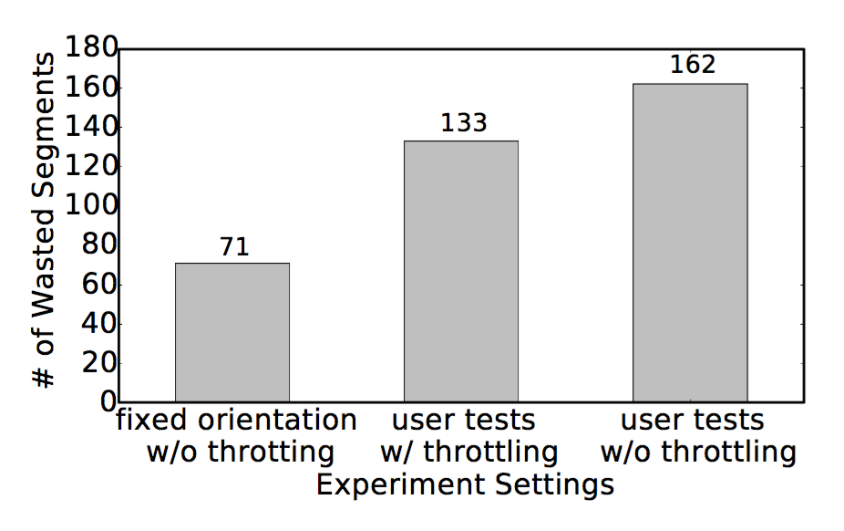
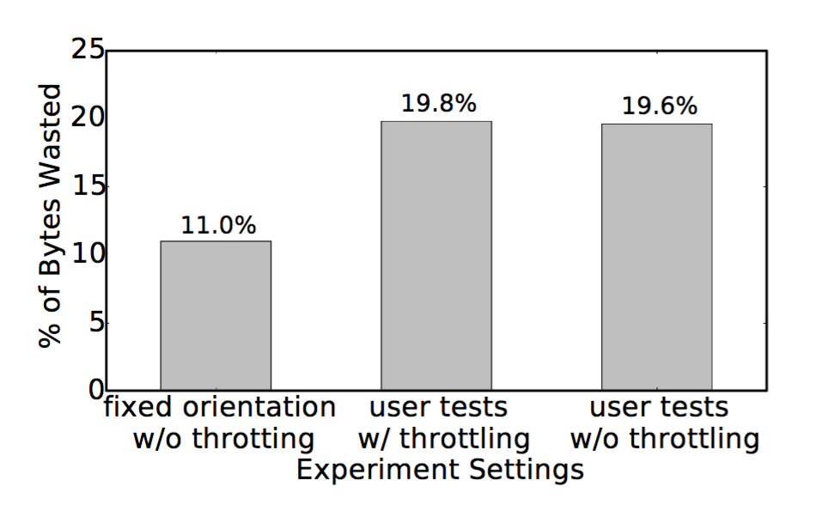
Real User Tests: Two Dimension Adaptation
57.4%
Total number of segments for entire video is 282.

Slide 18
Conclusion
Through reverse engineering, we discovered Oculus is using a new projection scheme, offset cubic projection.
It can produce better or similar visual quality while using less than 50% pixels under reasonable assumptions about user behavior, resulting in 5.6% to 16.4% average savings in video bitrate.
The combination of two-dimension adaptation can cause over 57% wasted segments, wasting about 20% of the total downloading bandwidth.

Slide 19
Thank You!
Questions?

Slide 20
Offset Cubic Projection
Top
Back
Bottom
Top
Back
Bottom
Left
Front
Right
Left
Front
Right
The standard cubic projection
The offset cubic projection
How does this new projection scheme works

